Slide 1

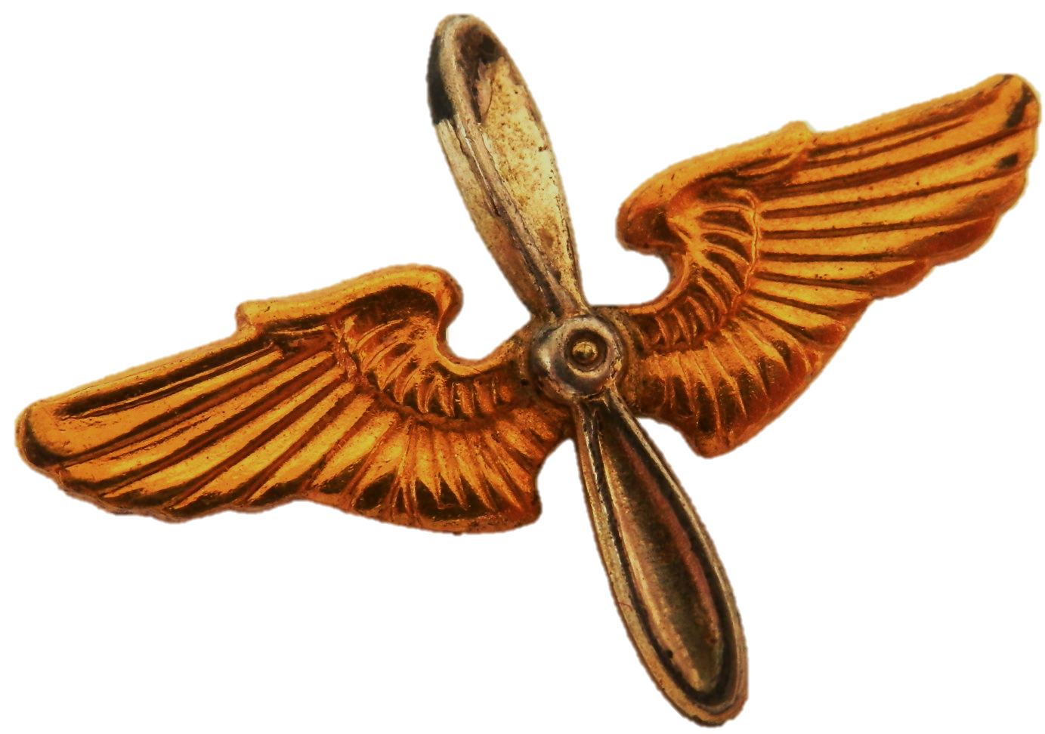
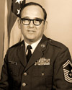
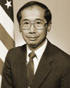
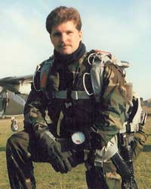
Enlisted
Communicators in History
CMSgt William L. Bethea
An expert in his field, Chief Bethea was selected to establish the first Air Force Information
Maintenance work center. He later served as superintendent of the facilities control branch at Headquarters Defense Communications Agency, where he managed around the clock technical control.
To change pictures:
Save the picture of the person you wish to use.
Single-left-click the grouped picture/shapes you wish to change on the poster. Single-left-click again on the picture.
Now single-right-click the picture and select “Change Picture” from the menu.
Choose the picture file you saved.
You may wish to single-left-click the grouped picture/shapes and single-left-click the new picture again to adjust its size or crop it—especially useful if the new picture is not the same aspect ratio as the previous one.
DO NOT CHANGE PROP AND WINGS PICTURE!!!
Mr. Thomas J. Yium
Mr. Yium was enlisted from 1955 to 1959, after which he served the next 36 years in civil service. During this time, he served as director at Headquarters Air Force Communications Command, exploring vulnerabilities to electronic countermeasures, environmental disruption, and battle damage.
TSgt John Chapman
TSgt Chapman was a Combat Controller in Afghanistan, where coordinated air support and extraction for his team’s downed helicopter. He later succumbed to multiple wounds during a rescue mission. His team leader credited him with saving the lives of the entire team and he was awarded the Air Force Cross for heroism.
How will you leave your mark on the cyber operations domain?

